Slide 1
A Pitch For Python

Slide 2

(Fun) Facts
Invented by Guido van Rossum
Dutch
Benevolent dictator for life
Works for Microsoft now

Slide 3
(Fun) Facts
2nd place in Tiobe index of June 2021
Exists since 1989
Python 2 EOL in 2020
Python 3: not backwards compatible
Python 3: first released in 2008

Slide 4
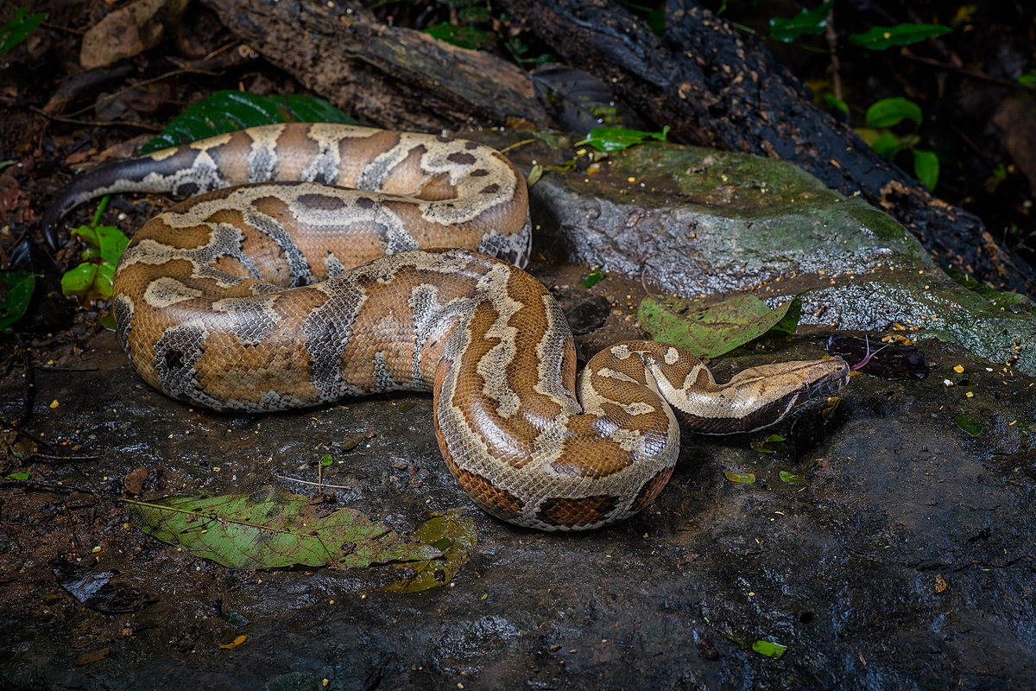
(Fun) Facts

Slide 5
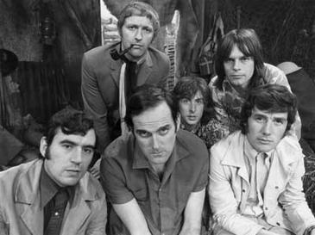
(Fun) Facts
https://www.youtube.com/watch?v=ZmInkxbvlCs

Slide 6
(Fun) Facts
Use Cases
Scripts
Artificial Intelligence
Data Science
Web Scraping
Web Application Development
...

Slide 7
Language features
OOP support
null is None
Indentation is important
Java
if blackKnight {
arms = false;
legs = false;
System.out.println(“Invincible”);
}

Slide 8
Language features
Python (no semi-colon, no {}!
Var naming with underscores)
if black_knight:
arms = False
legs = False
print(“Invincible”)
But is different than
if black_knight:
arms = False
legs = False
print(“Invincible”)

Slide 9
Language features
Typing can be confusing
Variable has no type
Type is part of the object
Not checked at compile time!
Java
private int add(int a, int b) {
return a + b;
}
private String add(String a, String b) {
return a + b;
}

Slide 10
Language features
Python
def add(a, b):
return a + b
string_result = add(“spam”, “eggs”)
number_result = add(4, 2)

Slide 11
Language features
Package installer pip
Just like Java, a lot of libraries are available
Documentation is located below a function
def some_function(some_arg):
“””this is some function doing something
:param some_arg: some random argument
“””

Slide 12
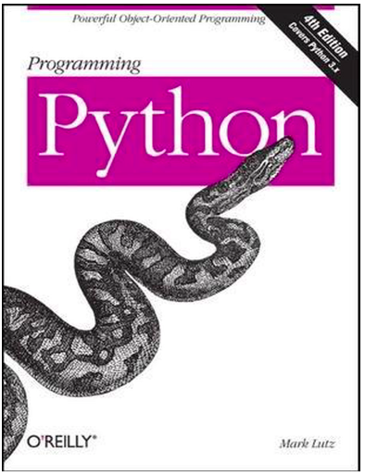
Book

Slide 13
Kata
A code kata is an exercise in programming which helps programmers hone their skills through practice and repetition.
https://docs.python.org/
PyCharm IDE
https://www.online-python.com/

Slide 14
Exercise 1
Print three statements
Use print

Slide 15
Exercise 2
Create a function which takes an argument and prints the argument text
Call the function several times
Syntax function:
def name():
statement

Slide 16
Exercise 3
Idem to exercise 2 but now use a main function
if __name__ == "__main__":
main()

Slide 17
Exercise 4
Print the value of an argument given to the main function
Can you print the help also?
Use argparse

Slide 18
Exercise 5
Create add function and use it with several types (e.g. string, number)

Slide 19
Exercise 6
Create a class kata with fields number and text
Create two instances
Print the instance
Print the fields of each instance
(tip: do so by creating a print function in the class and by using __str__)
class Kata:
def __init__(self, <arguments>):

Slide 20
Exercise 7
import unittest
class MyTestCase(unittest.TestCase):
def test_kata_string(self):
# Verify whether the Kata class __str__ works as expected
self.assertEqual(True, False)
if __name__ == '__main__':
unittest.main()

Slide 21
Exercise 8
Write some data to a CSV file export.csv
Write a header
Use columns ID and Item
Use references to Monty Python for the items
Tip: https://docs.python.org/3/library/csv.html

Slide 22
Other exercises
Export some data to an Excel file (xlsxwriter)
Create a basic GUI (tkinter)

